Slide 1
Customer Data Transformation Assessment (CDTA) - Sprint 2 Review
Remediation & ROM
July 28, 2020

Slide 2
Agenda
Sprint 2 Review
Sprint Progress
Current State Summary
Preliminary Profile Results
NG Data Governance Maturity Summary Observations
Deep Dive Discovery Summary
Looking to the Future
Appendix

Slide 3
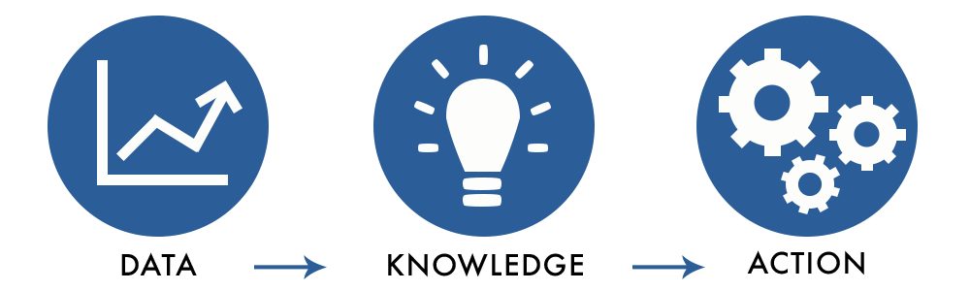
Sprint Progress

Slide 4
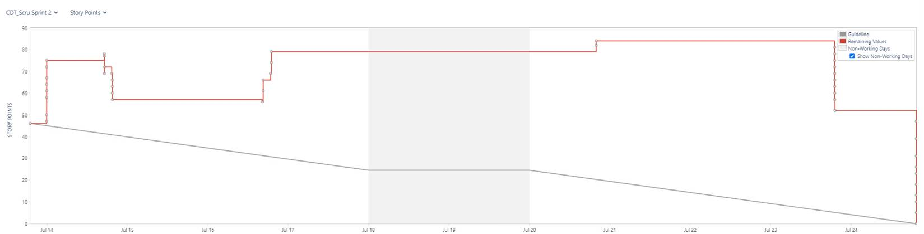
Sprint Burndown and User Stories
 | Planned | In-Progress | Completed
User Stories | 19 | 0 | 19
Story Points | 79 | 0 | 79

Slide 5
Current State Summary

Slide 6
Discovery Session Summary
Capgemini conducted 34 working discovery sessions with Business and IT that involved 250+ participants.
Team Discovery Sessions
Date | # of Participants | Business Group
29-Jun | 9 | EV Transportation 1
29-Jun | 7 | Customer Journey
30-Jul | 14 | New Connections Pre-Meeting
30-Jul | 8 | Energy Efficiency Pre-Meeting
1-Jul | 14 | New Connections (Sales) and Energy Efficiency use of Gridforce
30-Jun | 8 | Data Maturity Assessment
1-Jul | 13 | Data Scorecard Walkthrough
6-Jul | 9 | Customer Market Intelligence & Insights
7-Jul | 7 | Digital Delivery
7-Jul | 7 | Energy Efficiency and Product Implementation
8-Jul | 11 | Customer Energy Management NE
8-Jul | 7 | Customer Performance and Assurance
8-Jul | 5 | Contact Centre Operations
8-Jul | 8 | Billing Operations & AMO
9-Jul | 9 | Customer Energy Management NY
9-Jul | 9 | EV Transportation 2
10-Jul | 6 | Contact Center Vendor Management
Date | # of Participants | Business Group
10-Jul | 6 | Customer Delivery - IT
10-Jul | 6 | Customer Experience Products Pre-Meeting
13-Jul | 2 | Data Governance – Workstream Review
13-Jul | 8 | Customer Experience Products
14-Jul | 12 | Data Hub
14-Jul | 11 | Marketing
14-Jul | 9 | Data Management/Governance – Customer Domain
15-Jul | 9 | DER
16-Jul | 9 | Security
17-Jul | 2 | Executive Meeting - Orla
17-Jul | 2 | Executive Meeting – Charles
17-Jul | 6 | CDI Deep Dive
20-Jul | 8 | CIAP
22-Jul | 5 | Billing Operations Data Store
22-Jul | 9 | In-Demand
23-Jul | 10 | CCAE
24-Jul | 12 | CDI and CEMP
Sprint 2 Workshops/Interviews

Slide 7
Needs Assessment (Workshop Feedback)
Needs Highlight Known Challenges
Needs Assessment highlights the known challenges and highlights the priority of opportunities based on the workshop feedback:
Strong Data Tools & Capabilities – Integration and Data Quality needs are the highest priority needs and can address many of the foundational concerns for the customer data
Governance & Stewardship – Governance and related categories make up the 3rd highest priority based on pain points and opportunity. Add in data access & security this becomes a core foundational component to be addressed in the future state.
Single Source of Truth – A common need for a common customer identifier will help with the integration of data across the enterprise.
Greater Customer Insights – Business stakeholders continually mentioned need for access to data and better, more reliable reporting for customer insights, regulatory, product adoption & creation.
Notes:
Add in the ‘so what’: Did you find anything major/new
Perhaps add two columns: here’s what we validated, here’s what we learned
Here’s what we validated – Here’s what we learned -

Slide 8
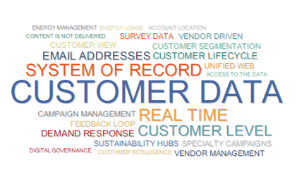


Common pain point references across multiple business groups
Many legs of customer data are connected. This is not a trivial exercise.
Notes:
94

Slide 9
Data Forensics – Understanding the Underlying Issues
Root Cause Categories
Impacted Data Elements
(in context of customer entity)
Relevant Systems
Data
Issue
Data Impact
Business Impact
Impact Level
SAP
Can’t Produce a Single Bill
Disconnected Data Models
Account
CSS
Unable to generate a single bill for the customer with non utility charges
Unable to
Aggregate Data
Customer Experience
High
Weak MDM
Charge Type
CRIS
Time Wasted on Repetitive Data Wrangling
105
Data Issues from Interviews Analyzed
98%
Have a High or Med Impact on Customer Business Operations
100%
of issues lack sufficient capabilities to be fully resolved
Capabilities consist of:
Platforms
Resourcing
Gov. Organization
Root causes, impacts and impact levels were inferred based on information shared in the workshop.
Would require further validation through business SMEs before addressing individual issues.
Training
Process
Catalogs

Slide 10
Preliminary Profile Results

Slide 11
Profiling Introduction – What we are looking for?
DQ Dimension | DQ Issues
Data Completeness | Are data values required by business processes missing?
Data Uniqueness (Duplicates) | Are data records duplicated?
Data Consistency | Do two related data values show a valid relationship or identity between the two values?
Data Conformity (Validity) | Do data values comply with format, length and range standards?
Data Accuracy (Correctness) | Does the data correctly describe the real world ‘thing’ being described?
Data Timeliness | Are data values current at the required time of use/publication?
Initial Focus areas during the Customer Data Assessment
Preliminary analysis only due to application of limited business rules
Notes:
Remove examples
Put a Box around Scope

Slide 12
Data Profiling Results
Initial data profiling results indicate a high level of potential data discrepancies that would
adversely impact customer service and drive substantial waste to cleanse separately within the each of the data silos.
Data Area
Summary Observations
Opportunity
SSN number varies in the range of 7-9 digits
Zip Code is inconsistent (e.g. Range varies from 7-9 digits)
Unclear field usage - same field is used to capture Landline as well as mobile phone numbers (range: 7-10 digits)
High level of duplicate records exist in the system
Issues with email address (e.g. Dummy values (XX.YY@ZZ.COM, etc.), most occurring value is Null etc.)
Invalid ISO 2 character state code ( i.e. AA, C, N, etc.)
Business Rules
Definition with Business
SMEs
CIAP – Staging Layer
Governance mechanisms to identify and address issues within source systems
Standardize Ingestion to eliminate data issues

Slide 13
NG Data Governance Maturity Summary Observations

Slide 14

NG Data Governance Maturity Summary Observations
“Data Stewards and Owners are not fully defined nor are their roles clear to them”
NG has a solid recognition of the need of data governance with the organizational structure, yet it still in it’s infancy as it is not yet integrated fully with the business and IT.
Current Governance Maturity highlights a minor formalization of approach and inconsistent application of processes, tools, roles & responsibilities that could lead to “business as usual.”
Current plan to have a “Hub & Spoke” data governance model may perpetuate current state data silos and processes cannot be properly leveraged.
A centralized data governance could be best suited to mastering customer data for faster adoption and change realization.
“Multiple tools for data governance”
“Within CIAP there were over 100 different ways the addresses were entered.”
“We have access to the BMS Compliance approach and action plan.”
Notes:
Look

Slide 15
Deep Dive Discovery Summary

Slide 16


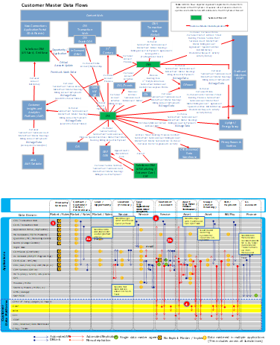
Data Lens – Incremental Discovery Focus
Business Partner Interview Focus
Incremental As-Is Analyses
Leading Utility Clients
Observations
1
Data flows and data dis-association are a function of NG having to manage across a legacy-dominated application environment using workarounds without a master plan
Master Data Flows
What is happening at the master data level & why?
Core Platform Capabilities
What can/can’t legacy platforms do with data?
Data Dimension Matrix
Where are critical data domains covered today, and where are the gaps?
Transactional/Feedback/Insights/
Personalization Flows
Where are the flow gaps, and what can/can’t be addressed until Apps Modernization?
Customer Data Experience Enablers
High-level view of the customer data digital interactions and logging capabilities throughout the customer lifecycle
2
Legacy capabilities inhibit source data access, data management, real-time data flow; significant logic needed across table structures
3
Data domains are fragmented and replicated throughout the landscape
CIAP data lake has become a pinch-point for integrated data access and insight creation
4
Lack of predictive intelligent personalization
Absence of integrated segmentation engine
Rudimentary integrated & automated next best action
5
Web data is stored various sources (Sprinklr, Kubra, PrefMgmt, Apps Insights)
Cannot easily track customers history, preferences, needs or predict behavior
Only some marketing communications (i.e, promote EasyBill programs) track clicks and opens
Function Mature
Function Maturing
Function Initiated
Emerging Plan
Opportunity
Notes:
Update the maturity circles
Add observations for 1-2-3

Slide 17
Incremental Discovery Focus - Customer Master Data Flow
1
Master data management must be a foundational part of the NG data transformation going forward.
Data Area
Summary Observations
Opportunity
Fragmentation of Systems of Record that overlap residential and commercial customers is long-term root of master data challenges
No master data management capabilities
Lack of persistent customer identifier, combined with need to inject upstream data validations and hygiene limit efficient transacting and burden downstream insight creation
Proliferation of data management platforms (e.g. CDI) and platforms to support Insight (CIAP, ADA, Revenue Warehouse, CCAE, etc.) manifests high-effort data management and inconsistent data outcomes
Timing differences in data flows between SoRs and SoEs, and latency in CIAP integration that is created dynamically and weekly present both real-time customer engagement with precision, and timely go-to-market support
Lack of longitudinal data management and consistent archiving / preservation create gaps and risks in preserving customer mastered data
Persistent Customer Identifier
Master Data Management
Alignment And Streamlining Of Platform Data Requirements Across The Landscape
Simplification Of Data Publishing For Internal / External Platform Consumption & Reporting Requirements

Slide 18
Incremental Discovery Focus - Core Platform Capabilities
2
Given the legacy landscape, data access needs to be moved outside the mainframe world closer to its end user.
Data Area
Summary Observations
Opportunity
Data Sources
Overlapping systems of record within the application landscape without an MDM strategy
Customer data quality is not managed consistently across applications
High priority data issues are not getting resolved, thus impacting business value realization downstream
Numerous integration and data systems for each set of use cases, resulting in a large network of separated data stores, ODS systems, marts, or data puddles with overlapping and inconsistent data (some of these are known and new ones get discovered with every discussion)
Separate data models that struggle to get combined into a single view in a cost efficient fashion.
Lack of Business Data Views makes even the limited data accessible only to SMEs
Increased costs of doing analytics or reporting. Driving insights requires going to the source, aggregating and transforming information, every time.
KPIs are not linked to data that is required to derive them
MDM Strategy and Expanding the Data Governance Organization
Data Ingestion & Repositories
Common Cloud
Data Platform integrating currently silo’d information
Data Preparation, Access, & Security
Establish Business Views of Data and a Secured Common Consumption Layer

Slide 19
Incremental Discovery Focus - Data Dimensions
3
A future state data model that optimizes data flows and use cases is imperative and will need to evolve as data management issues are addressed.
Data Area
Summary Observations
Opportunity
Data Models
Existing Data Models are not standardized across platforms
Data mapping is through interface, table extract. Interfaces are point-to-point within the Customer Environment
Standardization of Data
Data Domains
Multiple intermediate waypoints for data movement - data lake/data warehouse/ODS
Lack of visibility into logic to merge data
New data (from Systems of Engagement, surveys etc.) get lost/stranded
Non-trivial movement of data through manual analytics & extracts
Minimization Of Data Replication Efforts
Notes:
Something around “This is a major system for the business and the business does not fully understand that. It has capabilities well beyond what it is being used for today and is probably the closest thing to a data lake that the company has today. We cannot lose this environment.

Slide 20
Incremental Discovery Focus - Transactional/Feedback/Insights/ Personalization Flows
4
Actionable personalized insights can be built through integrated feedback data, and
“allow the data to work for the company, not the company to work for the data.”
Data Area
Summary Observations
Opportunity
Existing data flow doesn’t facilitate integrated feedback and allow for personalized real time insights
Existing data integration architecture is not scalable for enterprise insights (CIAP is closest system to an integrated analytics view)
Unable to support detailed customer segmentation because lack of unique customer identifier (account driven)
New customer data flows take significant time to flow through to CIAP, slowing down iterative feedback of insights
Marketing campaign data is not automatically fed back into customer analytics which creates inefficient campaigns that are repeatable, scalable or iteratively personalized
Actionable iteratively personalized insights
Intelligent Insights
Repeatable, scalable integrated customer data

Slide 21
Incremental Discovery Focus - Digital Customer Interactions
5
NG needs to capture and leverage their customer’s multi-channel experience (inbound/outbound),
or risk losing growth opportunities and potentially missing the next generation of customers.
Data Area
Observations
Opportunity
Struggle to build single customer view
Web Account vs Account are not directly tied to the customer
Unable to segregate municipal or industry segmentation
Customer interaction data not linked between sources (eg social, call center)
Data is not treated as a shared asset (CIAP updated only once a week)
Integrated platform to view all transactions not evident (Application Insights)
Web data is stored various sources (Sprinklr, Kubra, PrefMgmt, Apps Insights)
Lack of segmentation engine
Data Integration & Unification
Unified Web Portal with
integrated customer data
Real Time Insights
Real time data not easily accessible to CSR and often outdated
Only some marketing communications (i.e., promote EasyBill programs) track clicks and opens
Intelligent call analytics not in one place & not integrated with other digital tracking data
Real time feedback & intelligent insights
accessible to CSR
Business Context
Lack of predictive intelligent personalization
CSR doesn’t know in depth details about customer prior to interaction
Cannot easily track customers history, preferences or needs
Next best action not widely evident (complaints, service issues & segmentation)
Cannot efficiently segment customers & predict behavior

Slide 22
Looking to the Future

Slide 23
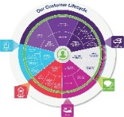



Thesis: Business Value Creation By Data Domain
Customer: Foundational / Unified Insights
Services: Journey Of Needs & Moments
The art of data management for NG’s Customer Business Unit
Interactions: From Communication To Trusted Advisor Relationship
Delivery Operations: Connectivity & Reliability
Products: Advantaged Adoption & Interaction
The data dimensions NG aspires to manage across
The business value that NG should derive from leveraging data
Ease of Data To Action
Frictionless Customer Experience Journey
Value Of Connecting
Optimized Energy & Utility Service Needs
Effective Product Adoption & Participation
Proactive Response To Situations
Advantaged Delivery & Vendor Operations
Notes:
Don’t do it just because there is a deadline.

Slide 24
Decomposition: What Value Is Created? Where Does It Accrue? What Is Priority?
Business Value Creation
Ease of Data To Action
Frictionless Customer Experience Journey
Value Of Connecting
Optimized Energy & Utility Service Needs
Effective Product Adoption & Participation
Advantaged Delivery & Vendor Operations
Proactive Response To Situations
Customer | Direct Value | Minimize Repetitive Data Requests | Time | Willingness To Engage | Lower Bills | Value From Investment | Lower Cost Of Participation | Value of Reliability
 | Indirect Value | Meets Expectation | Minimize Frustration | Energy Awareness | Digital Experience | Altruistic Decarbonization | Seamless Brand Experience | Trusted Relationship
National Grid | Direct Value | Effort | Call Deflection | Value Of Time Spent | Streamlined Delivery | Cost Of Acquisition/ PIM Goals | Lower Cost Of Service/PIM | Lower Cost To Respond
 | Indirect Value | Minimize Non-Value Added Data Work | Minimize Follow- Ups & Exceptions | CSR Satisfaction | Experience/Service Knowledge Gain | Competitive Reputation | Advantaged Delivery Base | Total Customer Impact
Priority/ Dependency |  | High | High With Blueprint | High With Blueprint | High – Comms & Service | High – Blueprint II | High – Not Yet Codified | Dream State/ Assess
Time-To-Value |  | Immediate to Mid-Term | Near-Term To Mid-Term | Near-Term To Mid-Term | Near-Term To Mid-Term | Near-Term To Full Realization | Mid-Term Evolution | Mid-Term To Long-Term

Slide 25
Capability Derivation – What Are The Customer Data Enablement Priorities
Business Value Creation
Ease of Data To Action
Frictionless Customer Experience Journey
Value Of Connecting
Optimized Energy & Utility Service Needs
Effective Product Adoption & Participation
Advantaged Delivery & Vendor Operations
Proactive Response To Situations
Foundational
Persistent Customer Identifier/Links
Mastered Data/ At Point Of Action
Single 360 Real-Time Data View
Digital Insights/ Pattern Mgmt.
Integrated / Omni Campaign Mgmt.
CSR Analytics & Optimization
Actionable Insights / Longitudinal View
Situational Awareness
Foundational Plus Build-Out Into New Apps/Around Legacy Apps
Data-Enabled Capabilities/Outcomes
Note: Data Governance & Data Quality are additional foundational capabilities requisite to all the above.
Notes:
Can creative change the Harvey Balls and update how they are represented?

